Slide 1
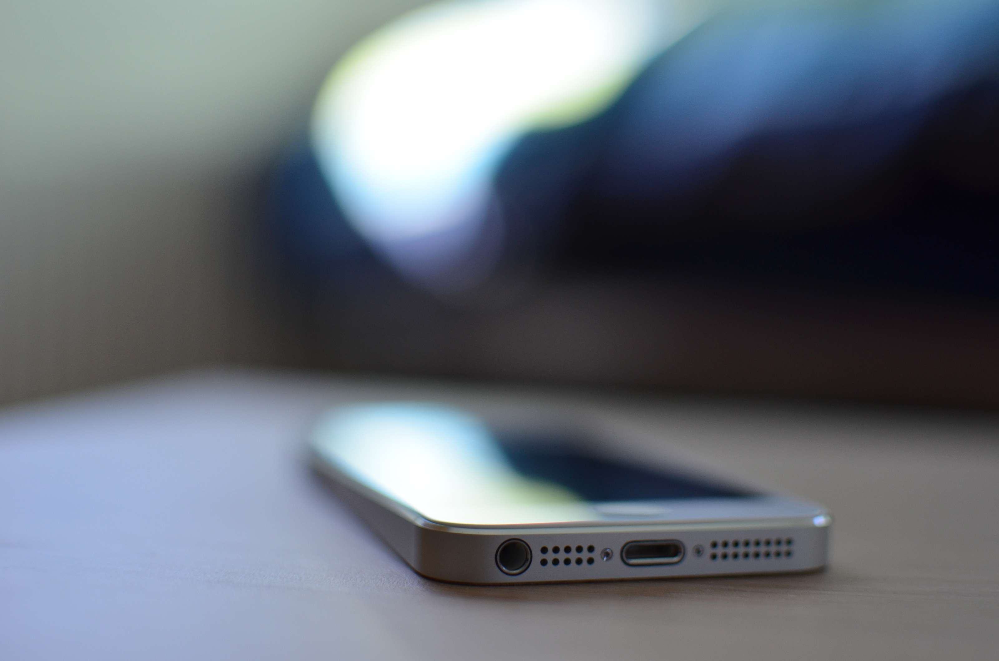
Marketing Quick Facts
Prepared For: Follow Black Dollars / Mrs. Nichol Jennings-Goodman

Slide 2
General Marketing & Consumer Facts
The average US middle class income in 2015 was approximately $64,000.
In Q4 of 2015, consumers were spending 34.9% of their income on Goods (21.7% on nondurable goods- groceries, clothing, gas, etc.; 13.2% on durable goods- automobiles, furniture, electronics, etc.).
An average US household spends $3,997 a year on groceries.
Average American consumers spend $2,787 on food away from home (i.e. restaurants or food not purchased from a grocery store), a 6.2% increase from 2013.
Average American consumers spend $2,728 on Entertainment, a 9.9% increase from 2013.
For US consumers in February 2016, spending is up $3/day on things like restaurants, gas stations, stores or online (discretionary money only) since the start of the year.
Desktop online holiday sales were close to $56.4 billion in 2015. This was up 6% from 2014
In 2014, American consumers reported they would spend 54% of their income on electronics.
More than 1 in 10 American consumers report that they will never give up their caffeine habits and that it would be the last thing they would cut back on.
Mintel forecasts an increase of almost 27% for dining out from 2014-2019.
US consumers are, on average, spending $1,786 on apparel and clothing; an 11.3% increase from 2013.
In 2015 Facebook reported that they have over 1.44 billion monthly active users, out of those 1.25 billion are mobile users.
The microblogging service, Twitter, reported 305 million monthly active users in 2015.

Slide 3
SMS Marketing Facts
Companies who properly employ SMS marketing messages can successfully reach 95% of mobile users.
SMS campaigns have a performance rate that is seven times greater than email.
90% of SMS loyalty club members report having benefited from the service.
75% of all mobile phones are capable of receiving SMS communication.
The current open rate of text messages is at 98% while email is only at 20%.
Over 90% of all text messages are read in less than three minutes.
Leads who receive SMS messages related to the transaction are 40% more likely to convert than those who don’t receive texts.
Approximately 25% of all marketers are now implementing SMS strategies.
44% of consumers prefer information about a product or service via text message versus other communication channels.
About 70% of employees prefer that their company use SMS to communicate with staff as well as customers.
20% of financial organizations use SMS to provide business continuity.
Over 80% of mobile phone users report that they use SMS communication for business.
Over 33% of professionals claim they can’t wait ten minutes before responding to a text message.
One out of every five consumers will prefer a text message to a phone call.
The average person will take 90 minutes to respond to an email, but they will only take 90 seconds to respond to a text message.

Slide 4
Mobile Marketing Facts
Approximately 60% of the average marketer’s time is spent on digital strategy, including mobile..
Studies show that about 65% percent of Americans check their mobile device as soon as they wake up.
Over 80% of teenagers between ages 13 and 17 use a smartphone..
There are more people own a mobile phone than use a toothbrush..
Over 50% of mobile searches result in actual sales.
Mobile coupons are ten times more likely to be used than print coupons.
Americans spend an average of 2.8 hours per day accessing digital media on a mobile device.
Approximately 91% of adult smartphone users keep their device within arm’s reach at all times.
44% of consumers prefer information about a product or service via text message versus other communication channels.
A mobile optimized websites receive higher search rankings on Google.
Approximately 80% of consumers own and use a mobile device.
Over 68% of businesses have somehow implemented mobile marketing tactics..
70% of a customer’s interaction with a brand is done via mobile.
Mobile marketing is projected to be a $46 Billion industry by 2019.
Over half of consumers report that they won’t recommend a website that isn’t mobile optimized..

Slide 5
SMS Coupon Facts
82% of consumers say digital coupons are a convenient option compared to printed coupons
US adults who redeem digital coupons will be up 7.6% in 2015 to 121.3 million
30.9% of retailers said a percentage discount was the most effective customer incentive
45% would like to receive in-store coupons from their favorite brands
47.1 million people redeemed a coupon obtained from an app, mobile internet, QR code, or SMS on a tablet in 2013
Redeemable SMS coupons are redeemed at a rate of 8%-16% - compared to 2.7% for email coupons.
About 50% of US consumers make a direct purchase after receiving a discount coupon from a business.
SMS coupons have redemption rates 10x higher than their printed counterparts.44% of consumers prefer information about a product or service via text message versus other communication channels.
When asked why they would scan a QR code, 87 percent of smartphone users said it was to access a coupon, discount or deal. Approximately 80% of consumers own and use a mobile device.
It is estimated that there will be around 104 million mobile coupon users in 2016 (about a 70% increase from 2013).
90% of mobile coupons are redeemed within 3 days of the consumer receiving it.
49% of US smartphone owners have used a mobile coupon on their devices.

Slide 6
‘
General Marketing & Consumer Facts
http://www.npr.org/sections/money/2015/03/19/394057221/how-much-or-little-the-middle-class-makes-in-30-u-s-cities
http://www.bls.gov/news.release/cesan.nr0.htm
http://www.bls.gov/news.release/cesan.nr0.htmhttp://finance.yahoo.com/news/here-s-what-americans-are-really-spending-money-on-183425173.html
http://useconomy.about.com/od/glossary/g/consumer-spending-trends.htm
http://www.consumerreports.org/cro/magazine/2014/11/how-america-shops-now/index.htm
http://www.consumerreports.org/cro/magazine/2014/11/how-america-shops-now/index.htm
http://www.mintel.com/press-centre/social-and-lifestyle/america-is-back-to-pre-recession-spending-habits-of-save-less-and-spend-more
http://www.gallup.com/poll/189776/consumer-spending-slightly-february.aspx?g_source=position1&g_medium=related&g_campaign=tiles
http://www.bls.gov/cex/home.htmhttp://www.bls.gov/news.release/cesan.nr0.htm
http://www.fool.com/investing/general/2015/03/07/the-average-american-spends-this-much-on-groceries.aspx
http://www.comscore.com/Insights/Press-Releases/2016/1/Final-2015-Desktop-Online-Holiday-Sales-Reach-56-Billion-Up-6-Percent-vs-Year-Ago
Mobile Marketing Facts
http://www.cmocouncil.org/facts-stats-categories.php?category=internet-marketing
http://www.cmocouncil.org/facts-stats-categories.php?category=mobile-marketing
http://www.forbes.com/sites/cherylsnappconner/2013/11/12/fifty-essential-mobile-marketing-facts/#5c6473177b7e
http://gomobilebook.com
http://www.smartinsights.com/mobile-marketing/mobile-marketing-analytics/mobile-marketing-statistics
http://www.bloggersideas.com/mobile-marketing-facts
http://www.ninjalinkbuilding.com/mobile/15-amazing-sms-marketing-facts-and-stats
SMS Marketing Facts
http://www.forbes.com/sites/cherylsnappconner/2013/11/12/fifty-essential-mobile-marketing-facts/#5c6473177b7e
http://www.ninjalinkbuilding.com/mobile/15-amazing-sms-marketing-facts-and-stats
http://mobilemarketingwatch.com/sms-marketing-wallops-email-with-98-open-rate-and-only-1-spam-43866
http://connectmogul.com/2013/03/texting-statistics
http://pages.velocify.com/rs/leads360/images/Text-Messaging-for-Better-Sales-Conversion.pdf?mkt_tok=3RkMMJWWfF9wsRonuKvBZKXonjHpfsX97uouXa%2Bg38431UFwdcjKPmjr1YIHTcZ0aPyQAgobGp5I5FENSLLYWKpst6cJWA%3D%3D
http://www.exacttarget.com/blog/we-surveyed-5000-marketers-heres-what-they-said-about-marketing-in-2015
http://www.mosio.com/mobileanswers/the-competitive-advantages-of-mobile-text-messaging-stats-facts-and-figures
https://www.callfire.com/blog/2014/01/06/businesses-communicate-internally-with-sms
http://www.loyalty360.org/loyalty-management/article/Mobile-Customer-Engagement-Top-of-Mind-for-SCENE
http://www.eweek.com/small-business/businesses-texting-grows-more-widespread.html
https://www.linkedin.com/pulse/45-interesting-text-marketing-statistics-peter-davis
http://blog.hubspot.com/blog/tabid/6307/bid/24082/9-Amazing-Mobile-Marketing-Statistics-Every-Marketer-Should-Know.aspx
SMS Coupon Facts
http://www.vibes.com/resources/2016-mobile-consumer-report/
http://www.emarketer.com/Article/Marketers-Boost-Efforts-Reach-Coupon-Clippers-via-Mobile/1012488
http://www.emarketer.com/Article/Online-Discounts-vs-Free-Shipping-Battle-of-Ages/1011219
http://www.scanlife.com/trend-reports/consumer-behavior-preferences-infographic-2016
http://www.emarketer.com/Article/Majority-of-US-Internet-Users-Will-Redeem-Digital-Coupons-2013/1010313
http://pointofsale.com/Success-stories/Study-Shows-ROI-for-Mobile-Coupon-Redemption.html
http://www.jacobsclevenger.com/blog/10-amazing-sms-marketing-facts-and-stats/
http://www.forbes.com/sites/cherylsnappconner/2013/11/12/fifty-essential-mobile-marketing-facts/#5797d4387b7e
http://www.statista.com/statistics/275670/adult-mobile-coupon-users-in-the-united-states/
http://codebroker.com/mobile-engagement-platform/2014-mobile-facts/

